Slide 1
Data Engineering Project
Data Lake(GCS) Data Warehouse(BigQuery) Visaulization(Google Data Studio)
Group 09
Sanjeev Anant Patil
Jongbok Lee
Usama Shehroz

Slide 2
1. Problem description
Goal is to design and implement a pipeline for processing Amazon product dataset, transferring it to an google DataLake and then to an bigquery Data Warehouse.
The pipeline should include steps for transforming the data in the data warehouse to prepare it for creating an analytical dashboard/report.
The final dashboard should contain visualizations, including a graph that shows the distribution of some categorical data (such as product categories) and another graph that illustrates the distribution of the data across a temporal line (such as actual rate and discounted rate for each product).
The goal is to make the data easily accessible and understandable for stakeholders through the use of visualizations and analytics on the Amazon Product dataset.

Slide 3
2. Supporting documentation details
File 1 : Airflow dag code file with dataset
File 2 : Terraform code file
File 3 : Dashboard file with report details

Slide 4
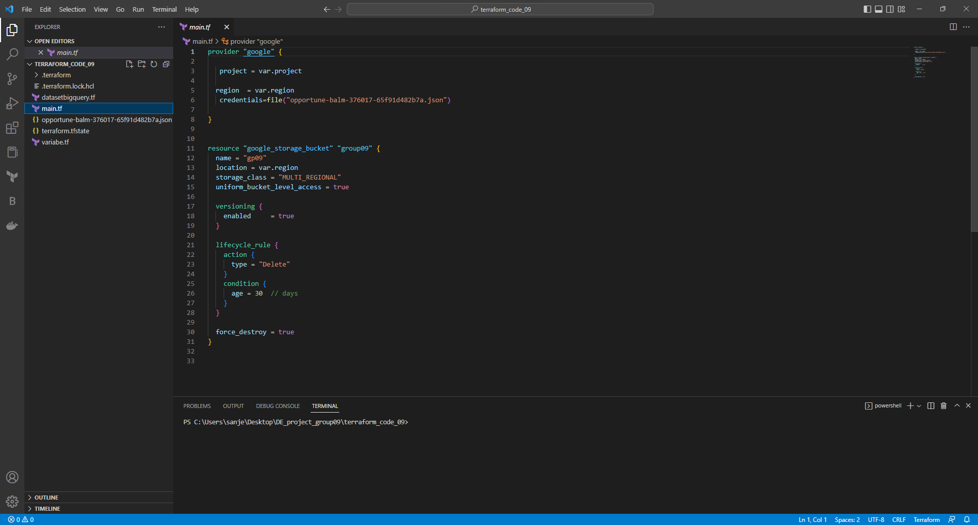
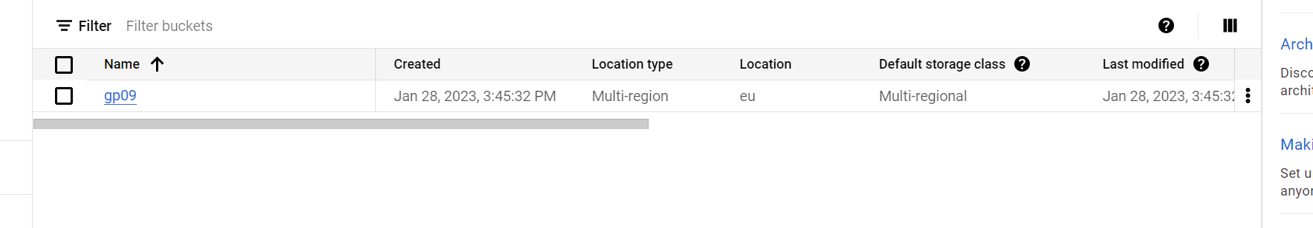
3. Google cloud usage : Using terraform, infrastructer is created on google cloud platform (Bucket & big query dataset)
Open terraform code file on vs code and change auth key details with your google auth key details. And add you key into the terraform code file.
Run terraform init command followed by terraform apply command to create bucket and bigquery dataset on GCP
Now if you check under cloudstorage tab. You will find bucket has been created

Slide 5
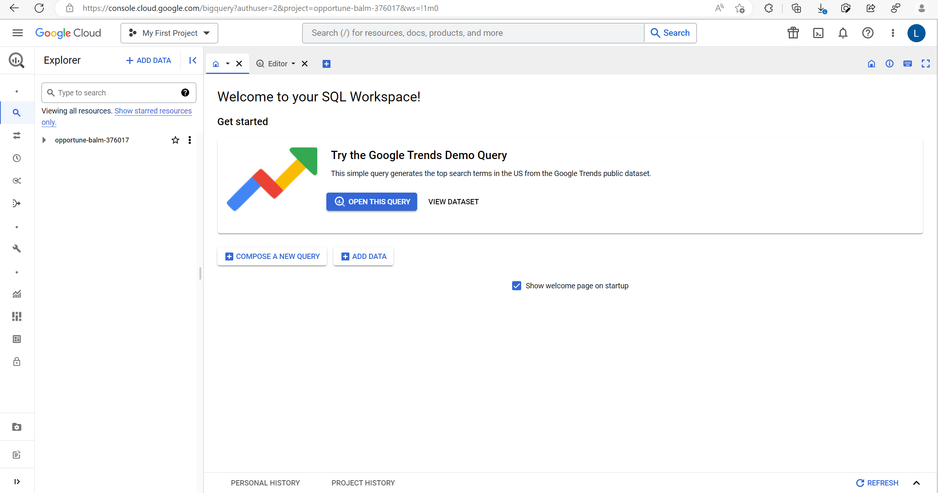
3. Google cloud usage : Using terraform, infrastructure is created on google cloud platform (Bucket & big query dataset)
Now if you check under bigquery tab. You will find bigquery dataset has been created

Slide 6
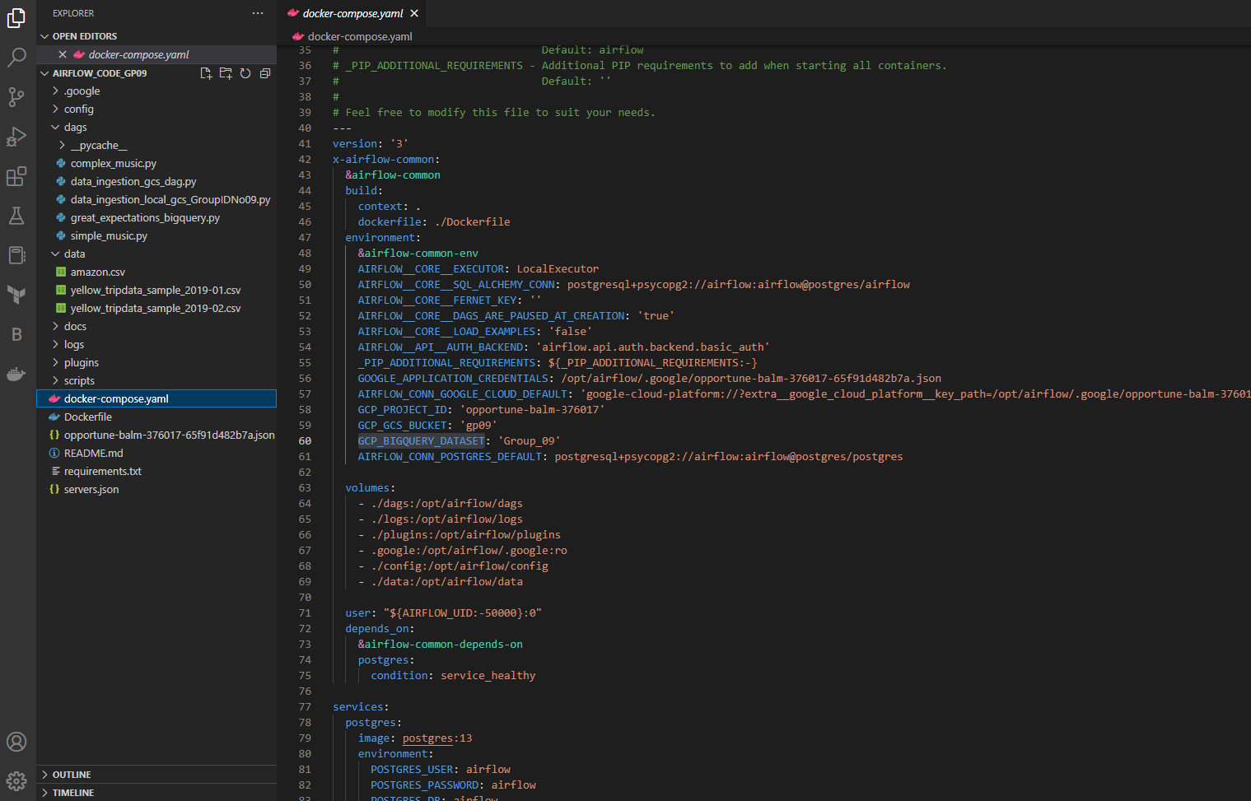
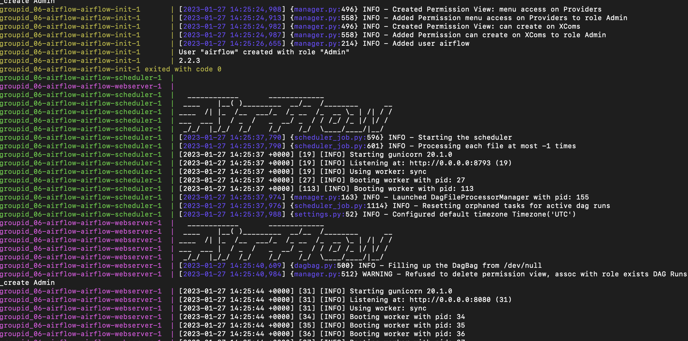
4. Data Ingestion workflow orchestration :
Add auth key in .google folder in airflow code folder and add your dataset in data folder.
Open airflow code folder in vs code
In docker-compose.yaml file change GOOGLE_APPLICATION_CREDENTIALS, AIRFLOW_CONN_GOOGLE_CLOUD_DEFAULT, GCP_PROJECT_ID, GCP_GCS_BUCKET and GCP_BIGQUERY_DATASET with your credentials.
If using different dataset make required changes according to your dataset.
Open terminal and download required python packages by running ‘pip install –r requirements.txt’ command.
After installation of packages run ‘docker-compose -p "groupid_09-airflow" up –build’ command to install airflow and ingest dataset

Slide 7
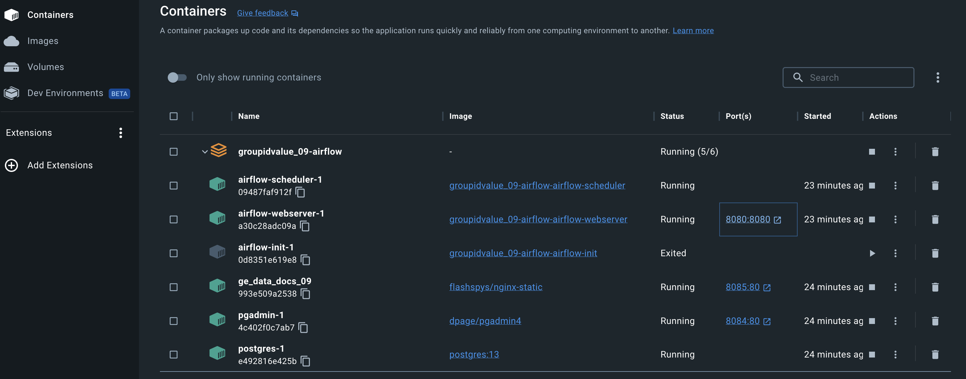
4. Data Ingestion workflow orchestration :
After airflow is connected in docker. You can see containers are created in docker.
Click on ‘8080:8080’ to open airflow webserver
On webserver you need to add username and password, add ‘admin’ for both.

Slide 8
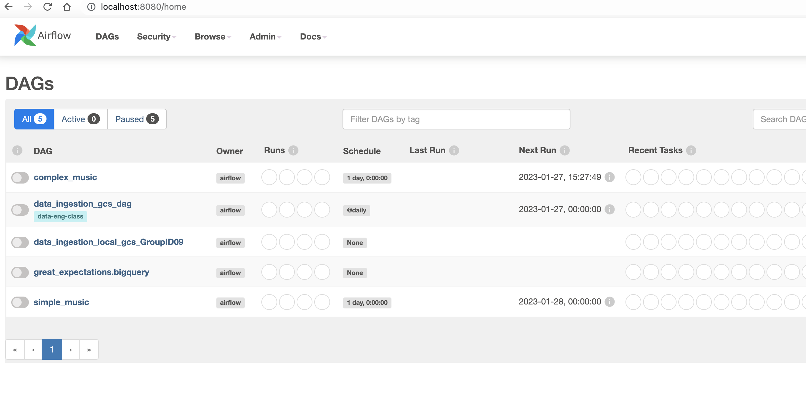
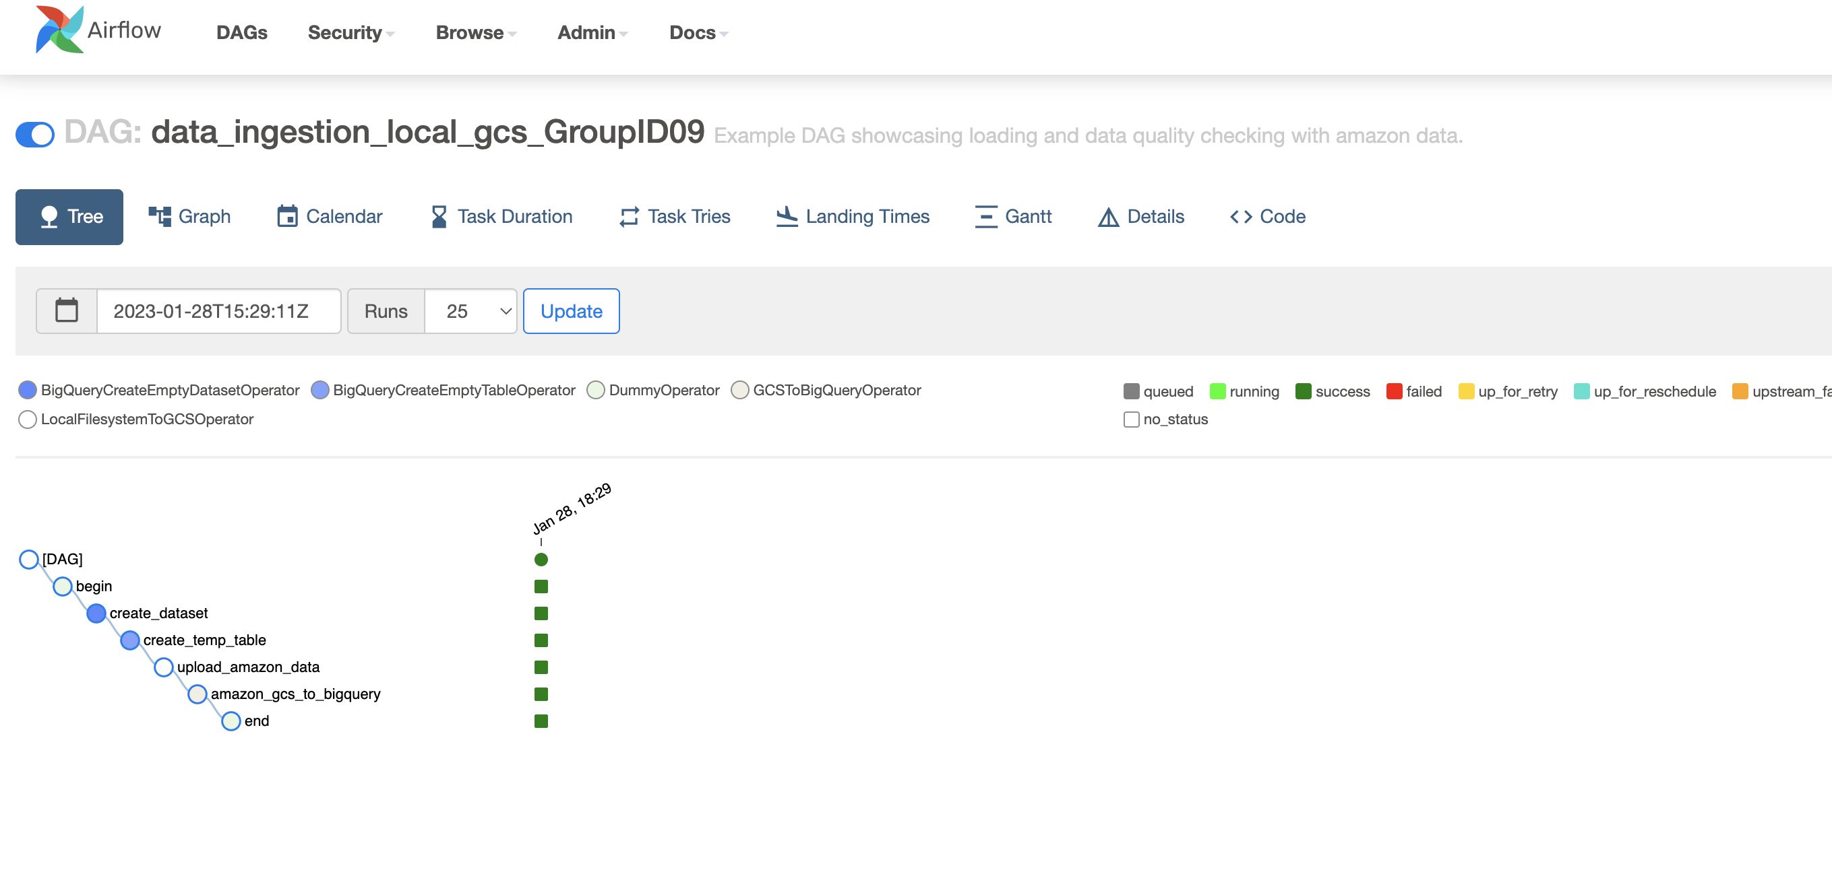
4. Data Ingestion workflow orchestration :
On webserver you can find DAG is updated

Slide 9
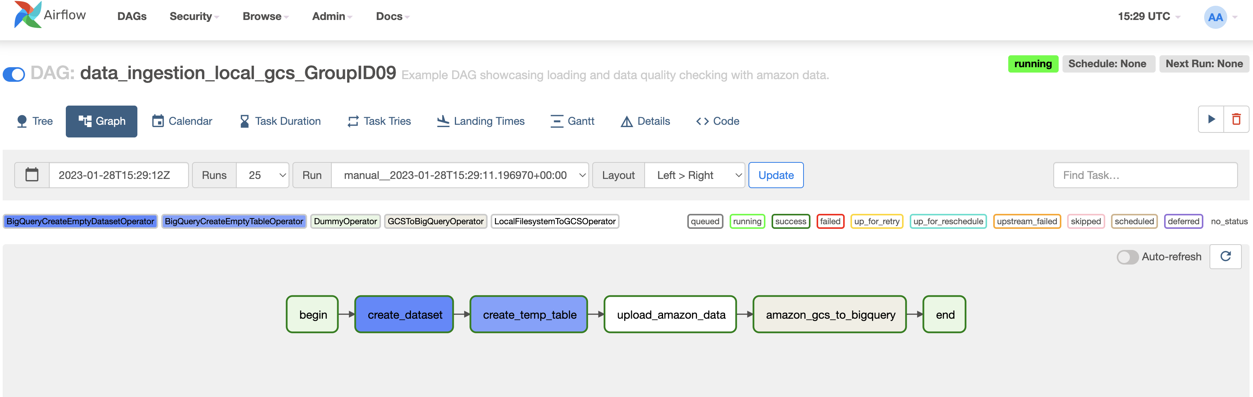
4. Data Ingestion workflow orchestration :
Run the DAG file to create the pipeline

Slide 10
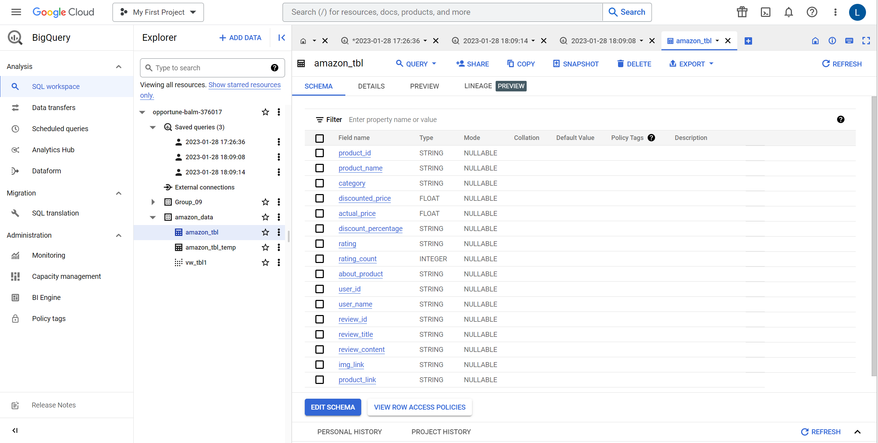
5. Data Warehouse :
Now open GCP, in GCP open bigquery tab.
Under bigquery dataset, which was created before. You will find data is successfully ingested into bigquery platform.

Slide 11
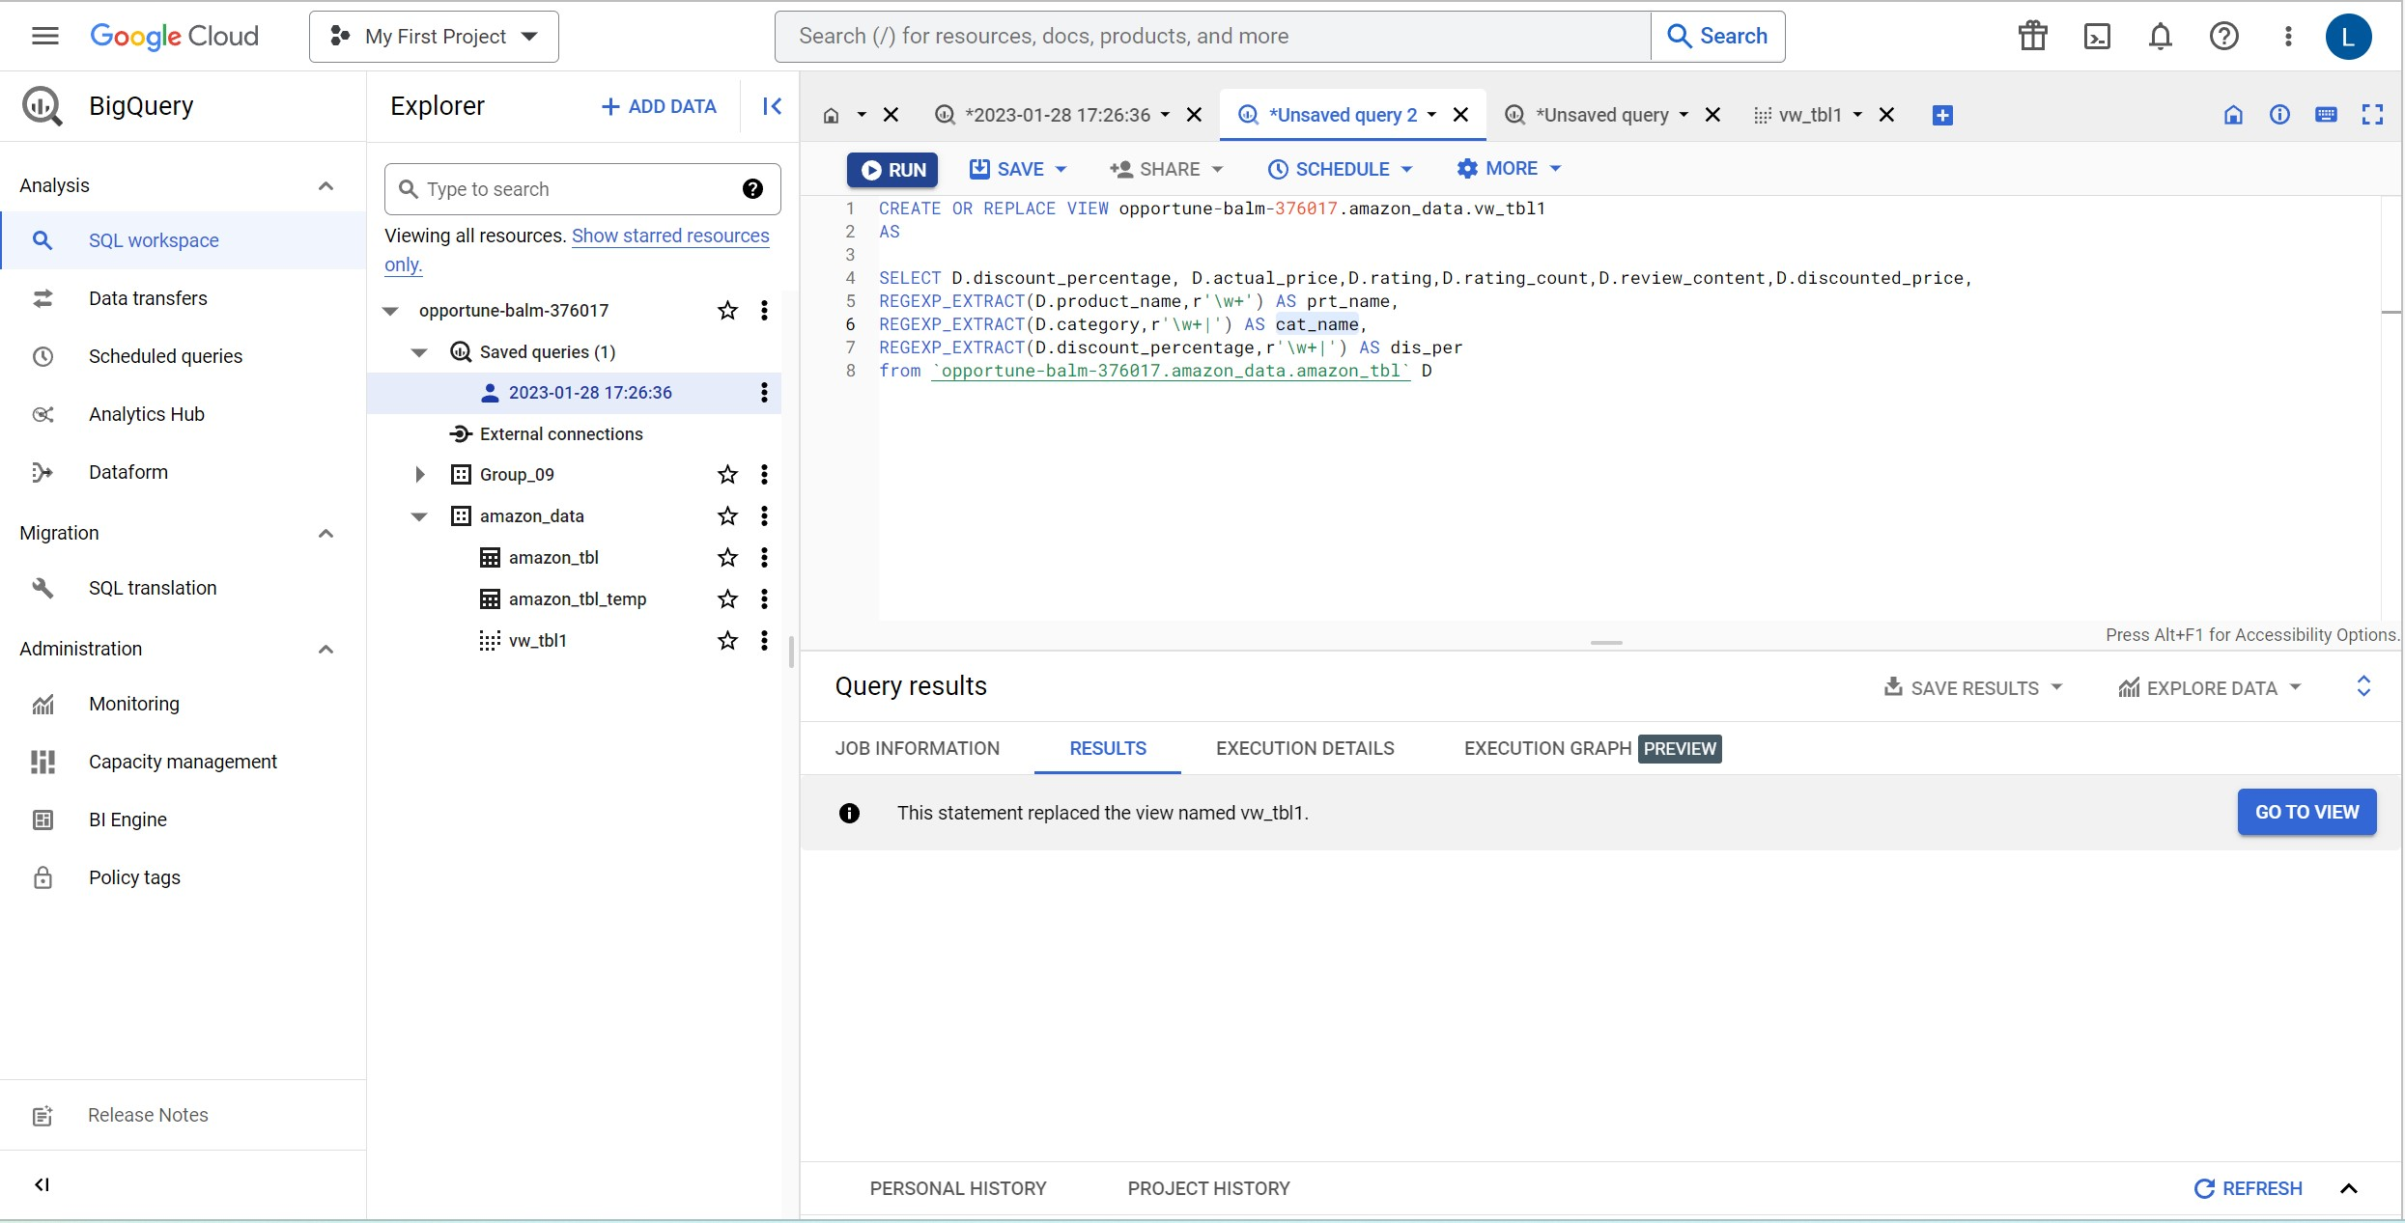
6. Transformations :
Click on query tab to open query sheet.
Create new view table as below to transform the columns product & category
After execution of query you can ‘find go to view’ button. Click on it to browse created table

Slide 12
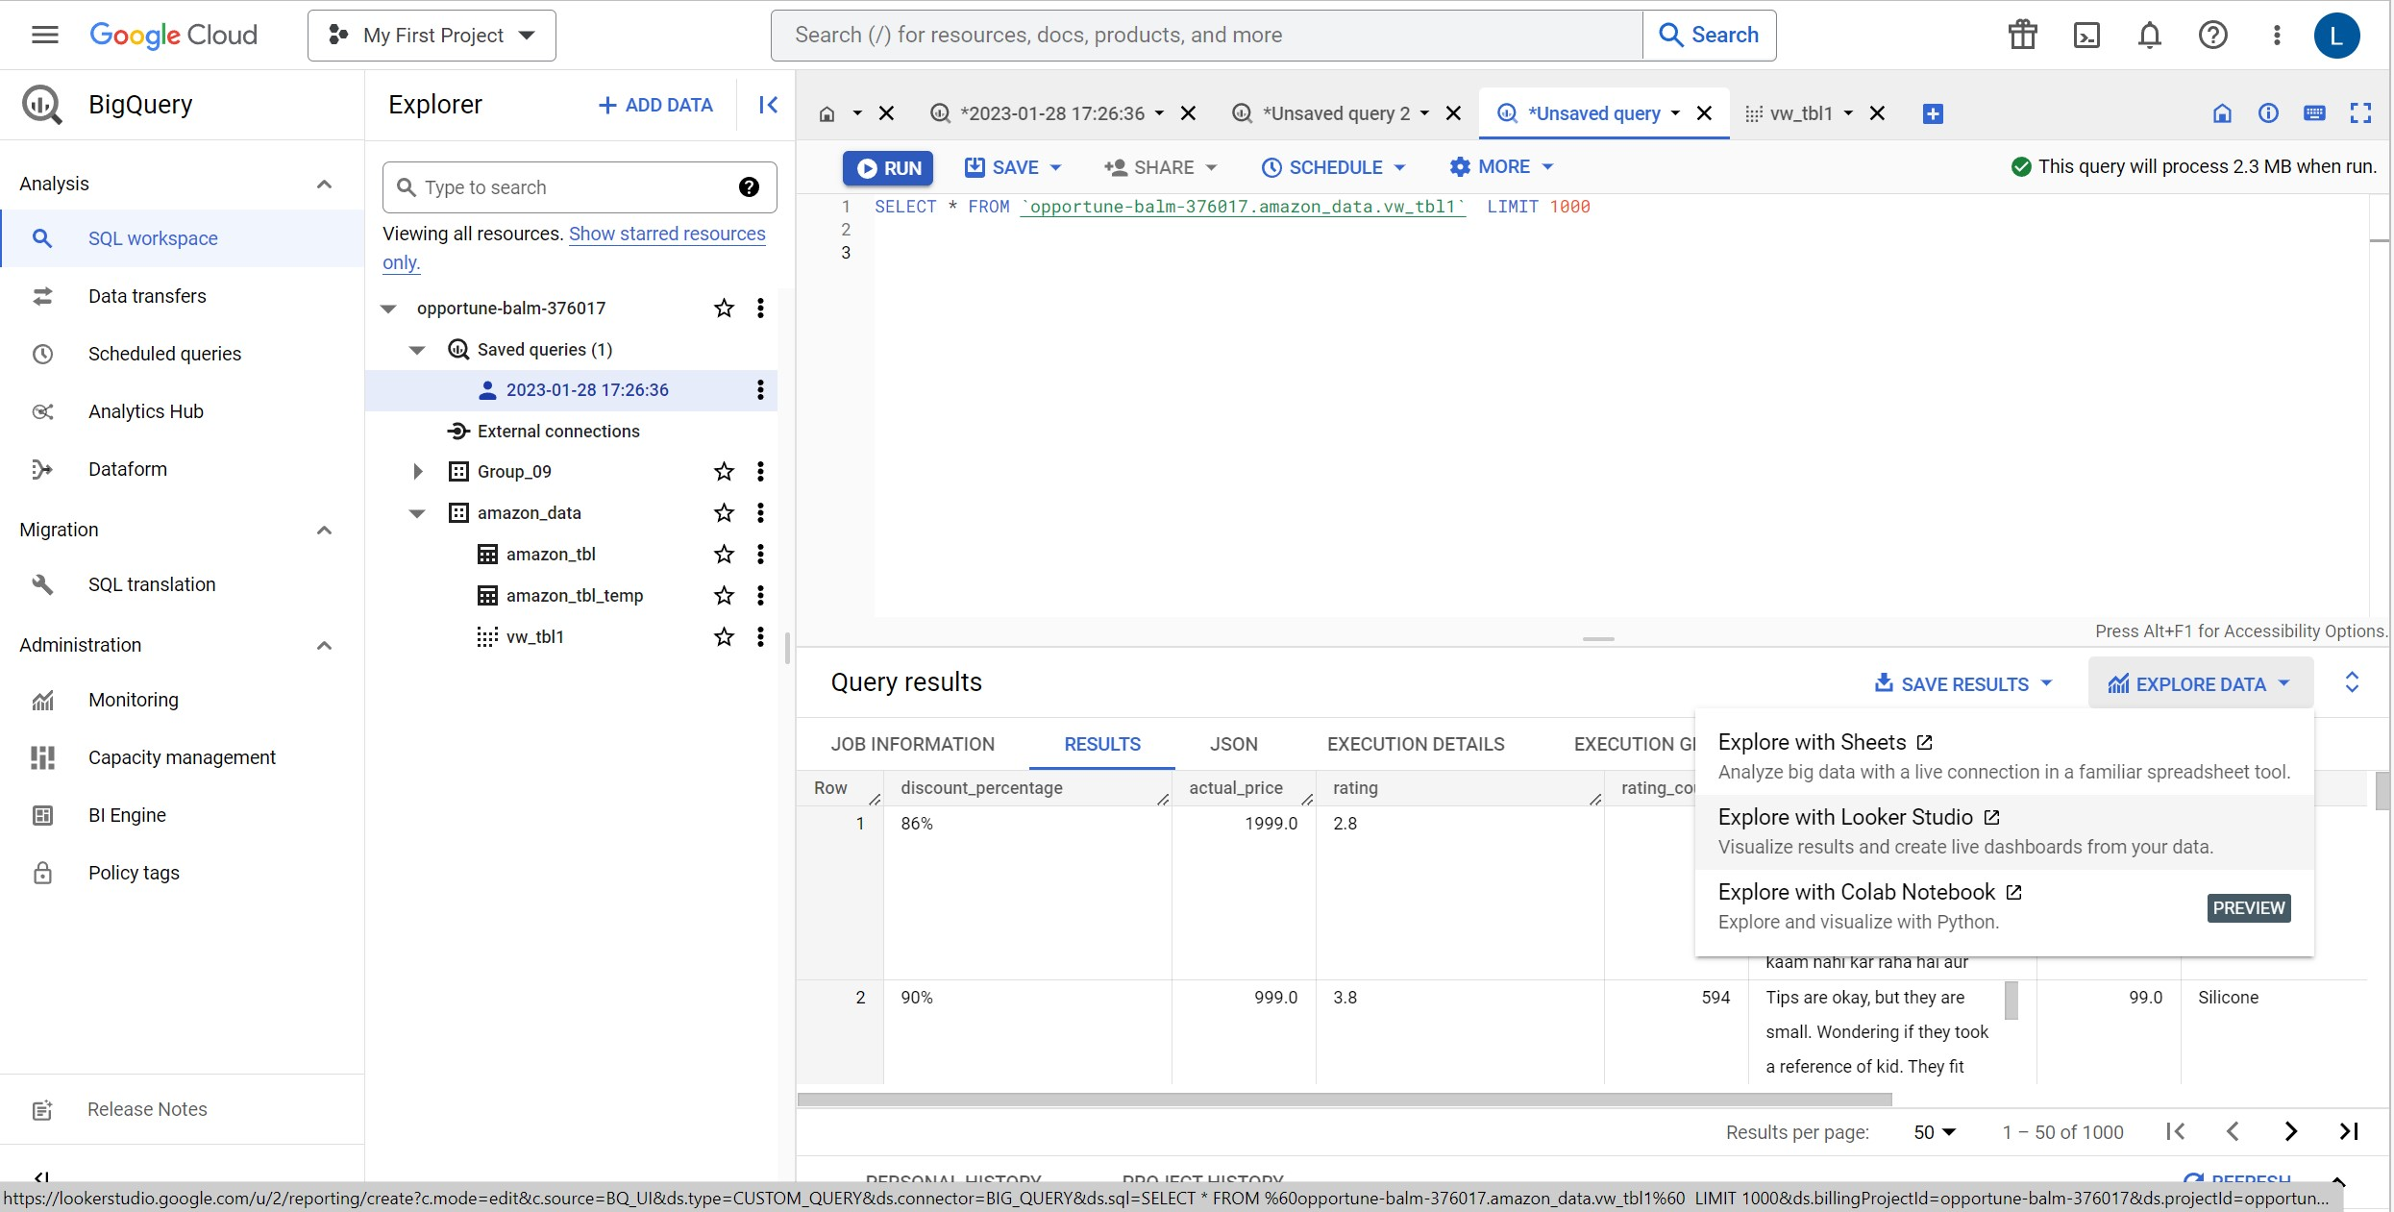
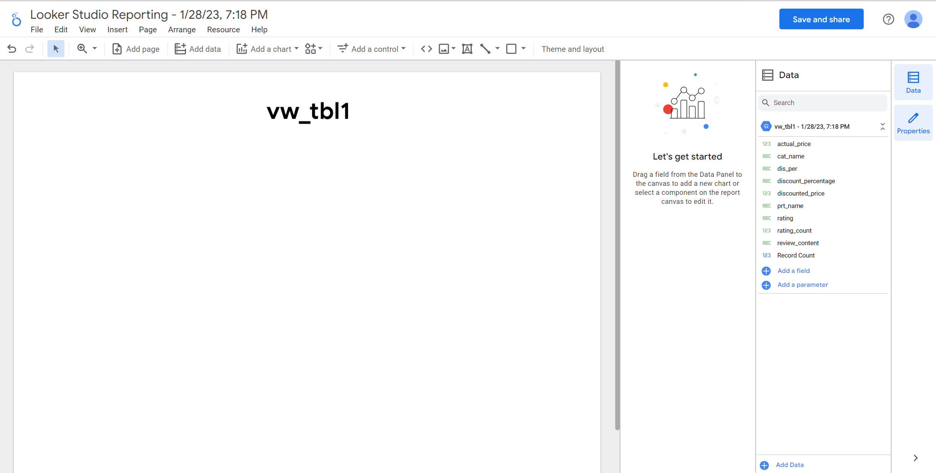
7. Connect created table to Google looker studio
After view is created run query for selecting all the column from your table.
After successful completion of query, click on explore data tab and open google looker studio for analysis of your dataset.

Slide 13
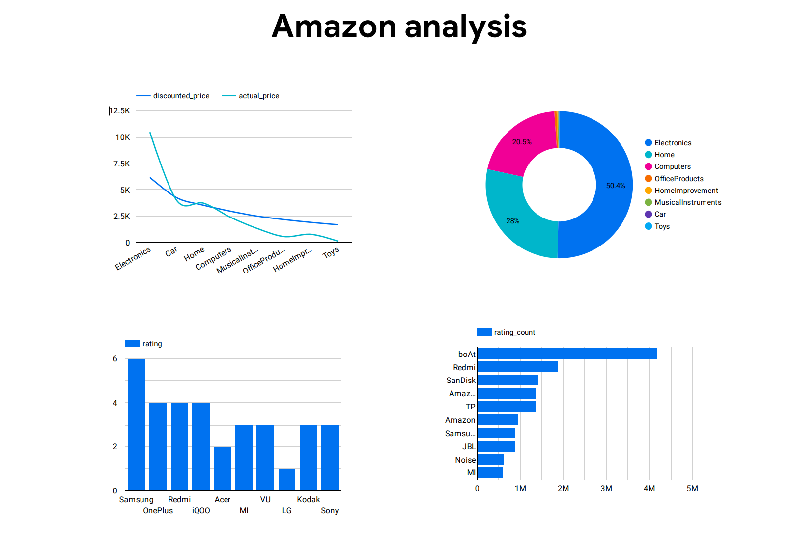
8. Dashboard : Visualized the chart as below

